Slide 1
CAN bus
Matthew Whitworth

Slide 2
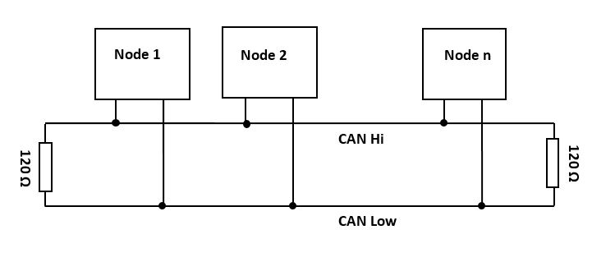
What is the CAN bus?
Controller Area Network
Twisted pair of wires connecting all nodes within a system
Effectively one signal from two wires
Nodes refer to ECUs such as motor controllers, BMS or the MoTeC

Slide 3
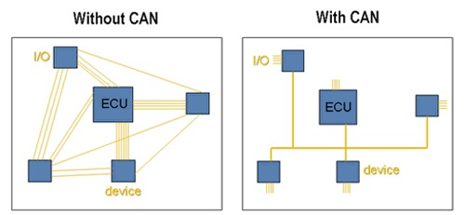
What are the benefits?
Industry standard
Resilient to noise
High speed data transmission
Greatly simplifies wiring

Slide 4
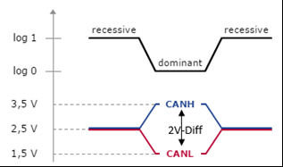
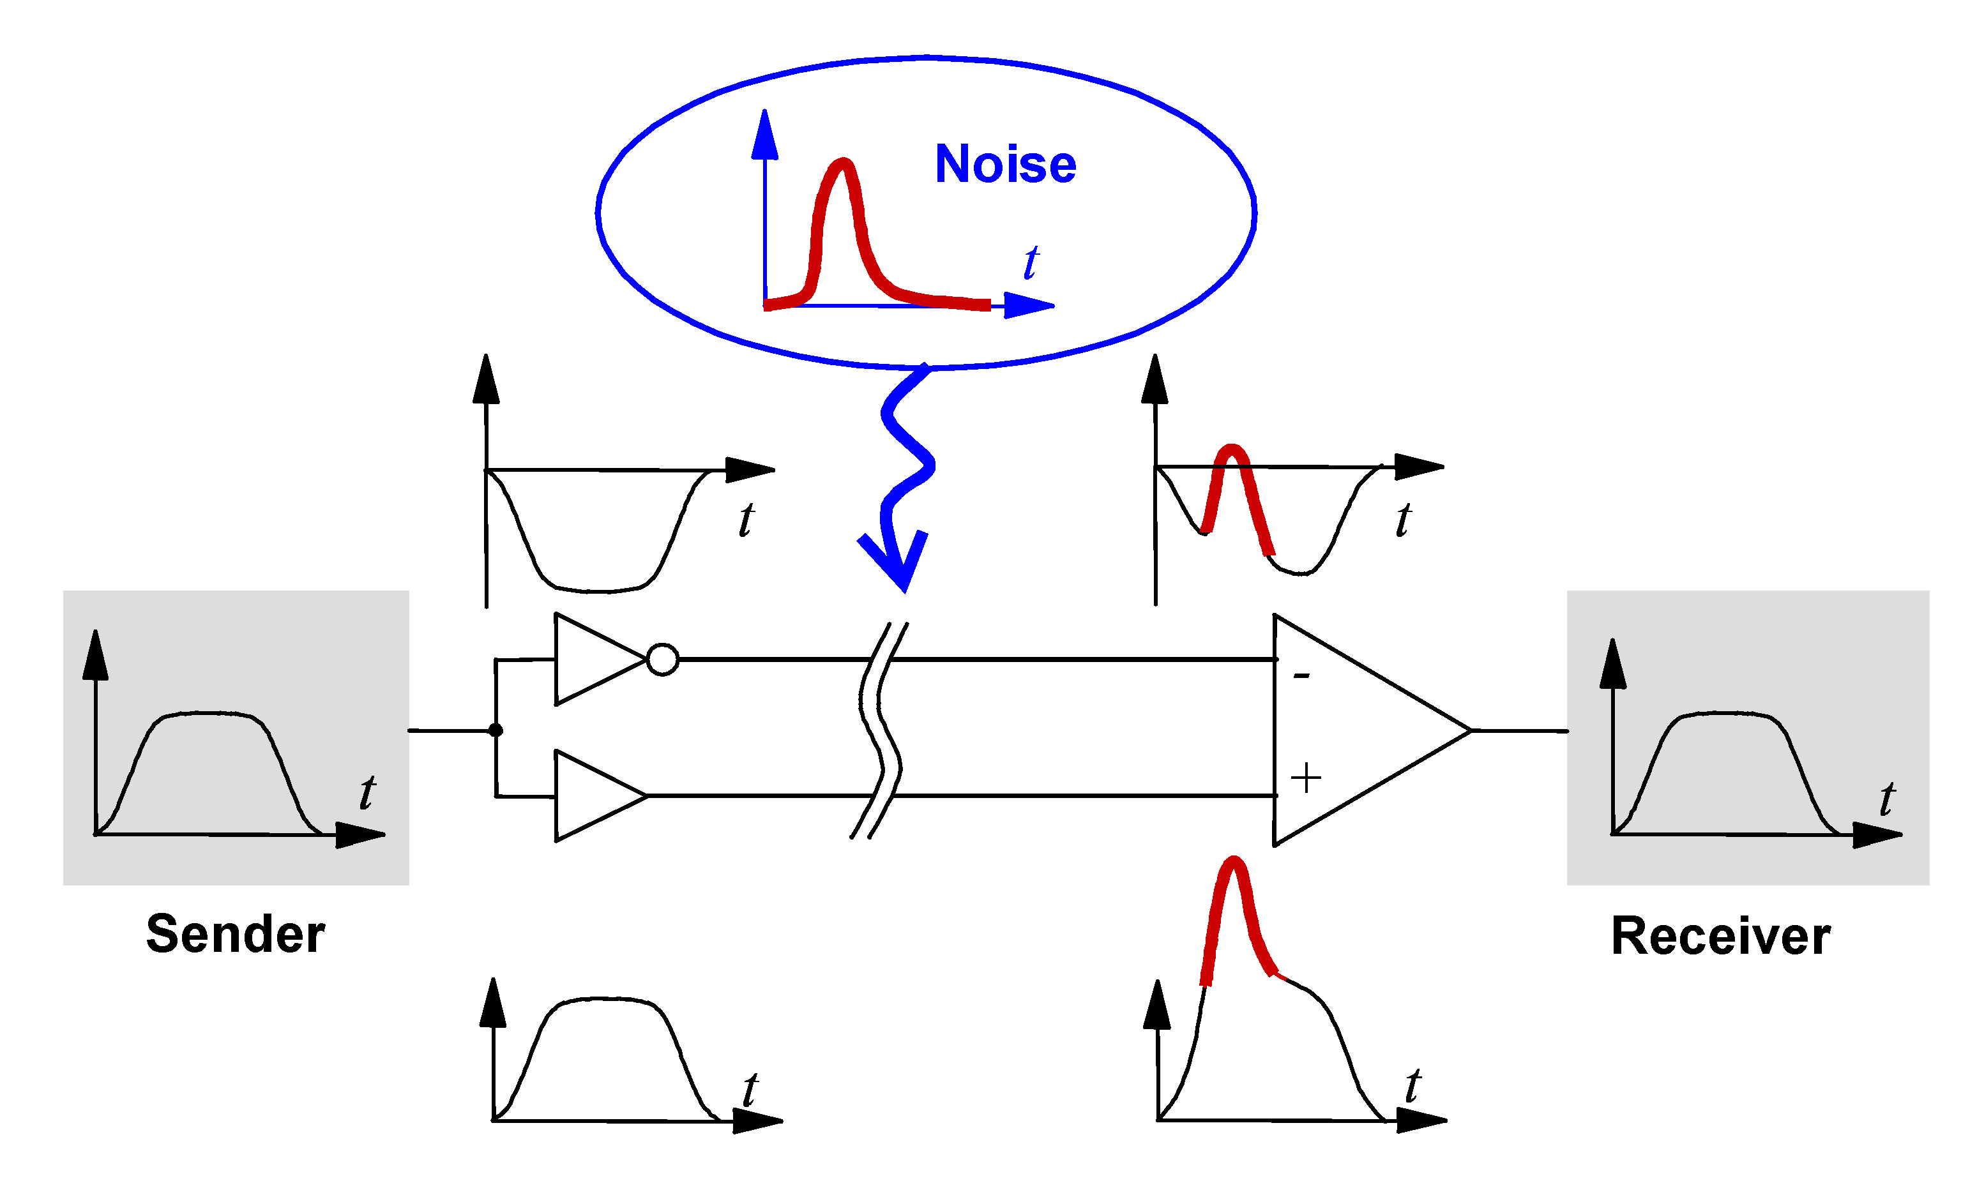
How it works - Hardware
Differential Signalling
Difference between high and low signals provides logical output
Dominant 0 system; 0’s overpower 1’s
Logical 0 when CANH high and CANL low
Noise present on both lines effectively subtracted out, CANH - CANL

Slide 5
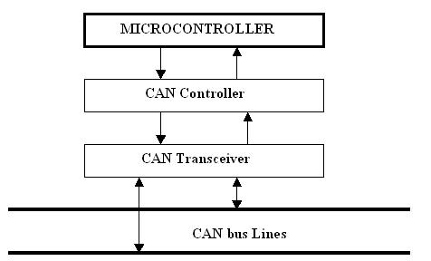
How it works - Hardware
CAN Bus Node Layout
Transceiver performs differential process and sends/receives noise free signal to/from controller
Controller stores sent or received messages from the MCU or bus until the bus is free or the MCU requests a stored message

Slide 6
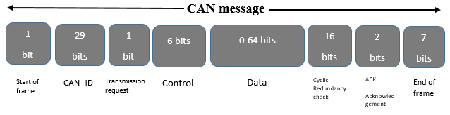
How it works - software
Extended CAN Message structure
Concerned with only data and ID sections
Extended gives 29 bit ID length instead of 11
Data typically treated as 8 separate bytes
More bytes for higher resolution data
Message Byte data example
1 | 2 | 3 | 4 | 5 | 6 | 7 | 8
Throttle Position |  | Front Brake Pressure |  | Rear Brake Pressure |  | Brake switch | Trail Brake

Slide 7
How it works - software
Message Prioritisation
Priority based messaging
Smaller ID’s are of a larger priority
CAN controllers operate in sync
Dominant logical 0’s effectively stop lower priority nodes from transmitting
Node 1 stops transmitting when it detects a dominant 0 overwriting its recessive 1
 | Binary ID |  |  |  | Decimal ID
Node 1 | 0 | 1 | 0 | 1 | 5
Node 2 | 0 | 0 | 1 | 0 | 2

Slide 8
How it works - Microcontrollers
Code Implementation
Teensy 4.0 Microcontrollers
FlexCAN_T4 library
Only need to define message ID and content and library will handle the rest
Refer to datasheets to interpret CAN messages from OTS components
Current Messages
Dash Data
Right Controller 1
Right Controller 2
Left Controller 1
Left Controller 2
BMS 1
BMS 2

Slide 9
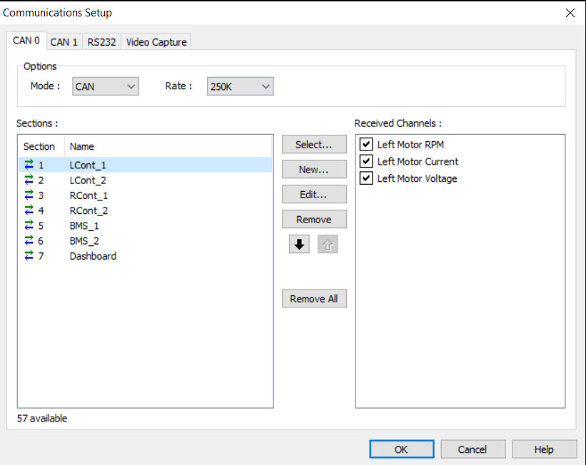
The Motec
Not critical to function of CAN bus
Sniffs and logs desired CAN messages
Lightweight datalogger as far as connections go
Intended to be interchangeable between EV2 and EV3

Slide 10
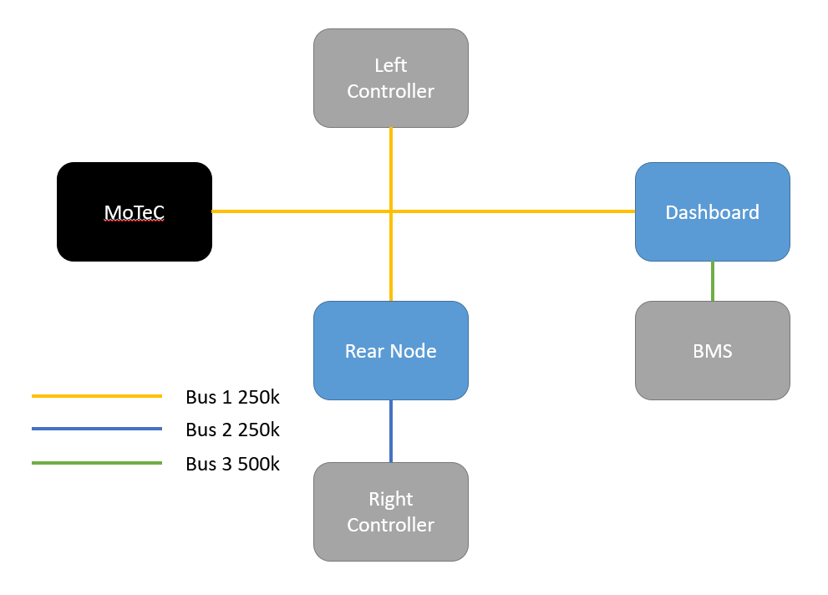
EV2 Implementation
Controllers share ID’s
Controllers and BMS operate at different baud rates
Interfaces required to change ID’s and baud rate to be put onto main bus

Slide 11
EV3 Plan
Main bus linking core vehicle components
Design intent is to put as much information as possible over the CAN bus
Branches from dash and rear nodes connecting to senor interfaces
Potentially separate buses if lines are too long

Slide 12
Questions?

